Slide 1
DS501 Project 2 What drives an efficient portfolio?
Mia Barger ▪ Quincy Hershey ▪ Alexander Moore ▪ Ethan Prihar

Slide 2
Problem introduction + motivation
How can a portfolio be constructed to minimize risk for a given level of performance?
How do results carry forward beyond the training dataset?
What do the characteristics of the dataset tell us about the limitations of linear approaches?

Slide 3
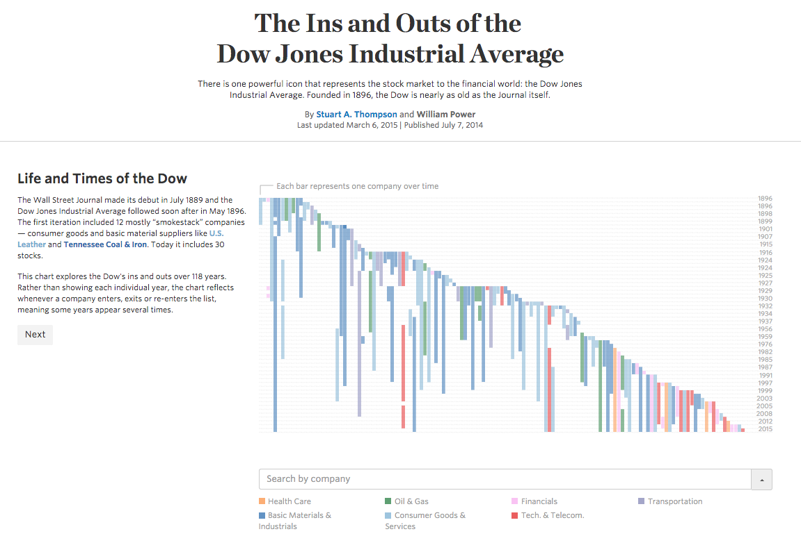
Selecting a data subset

Slide 4
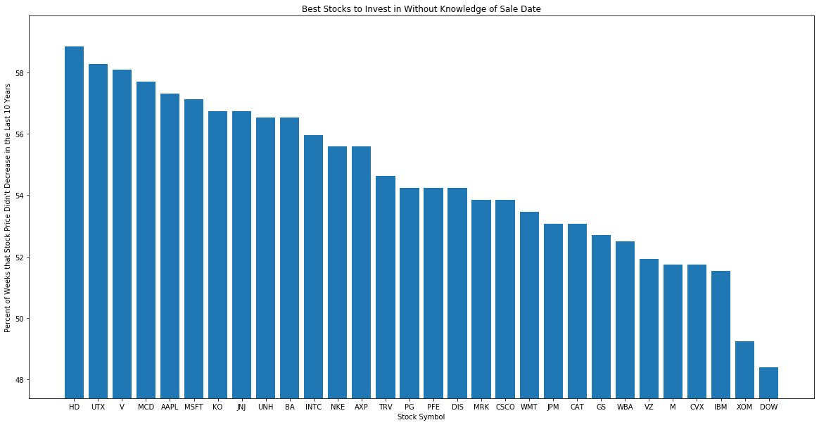
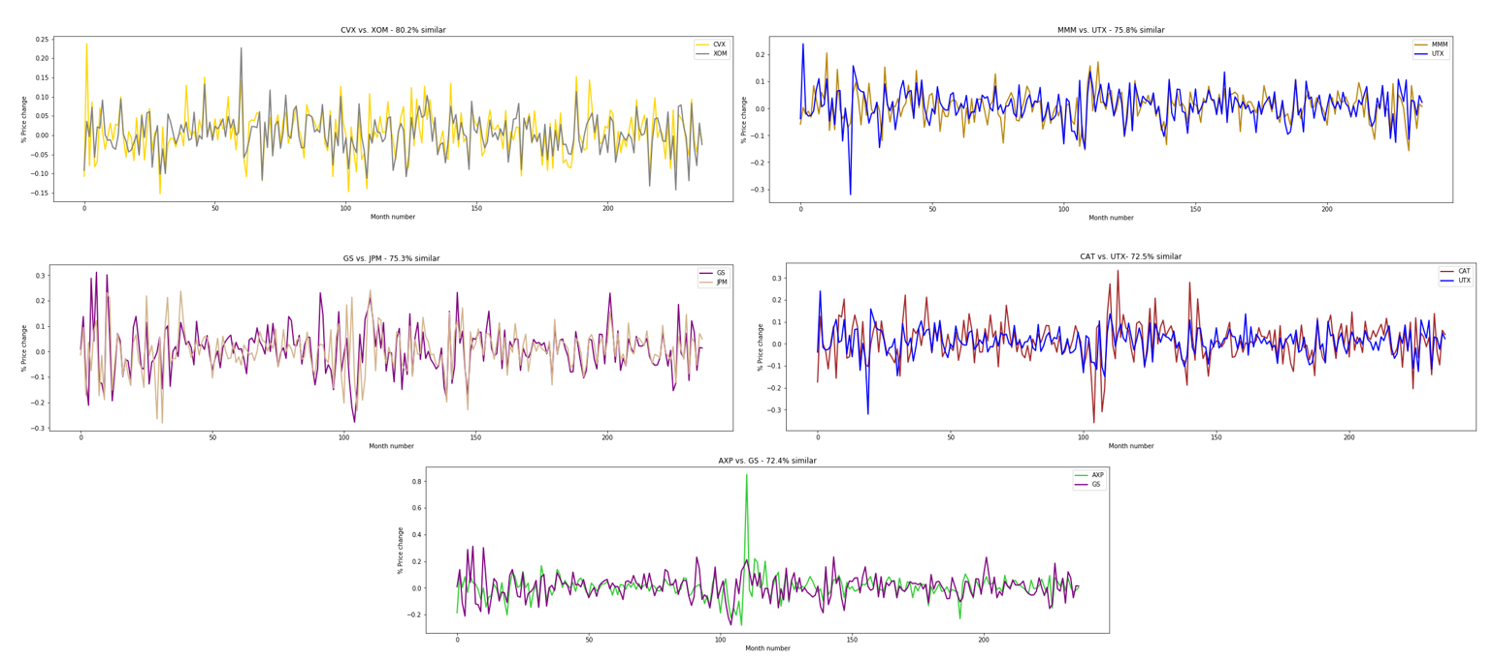
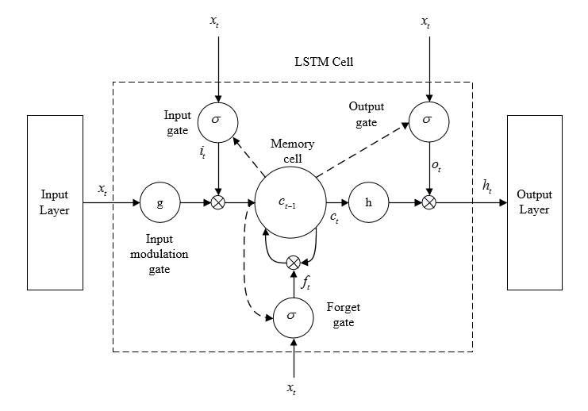
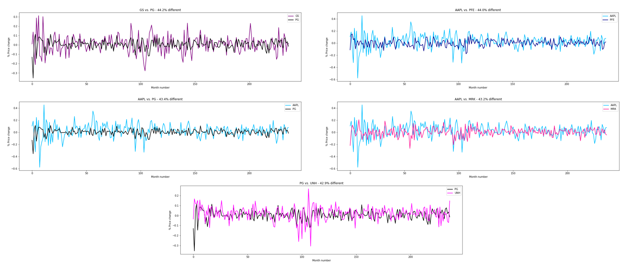
First effort… where to begin?
Investment behavior
Naïve Approach
Similar
Neural Network
Different

Slide 5
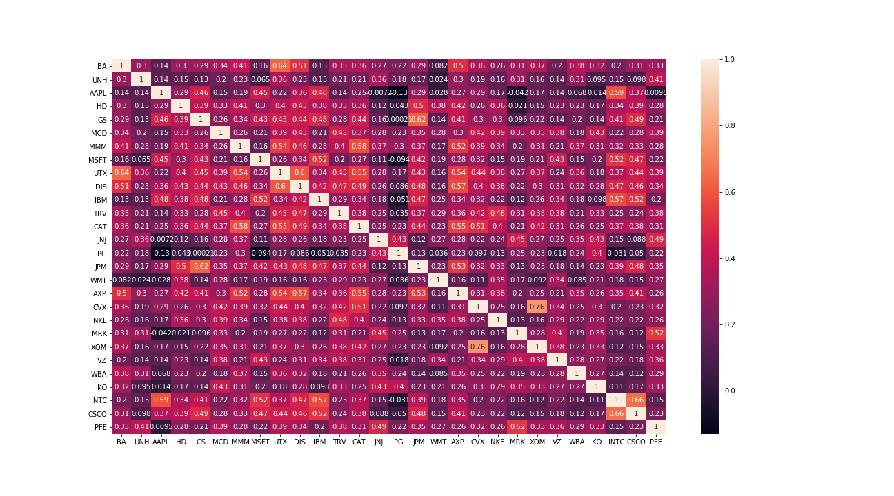
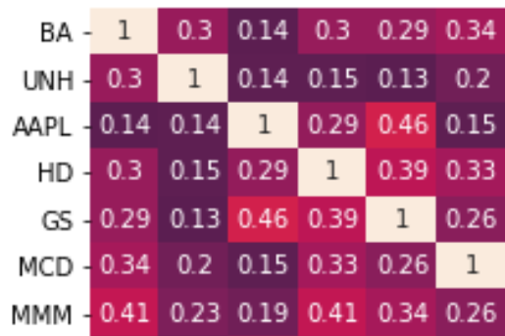
Measuring interrelationships in the data

Slide 6
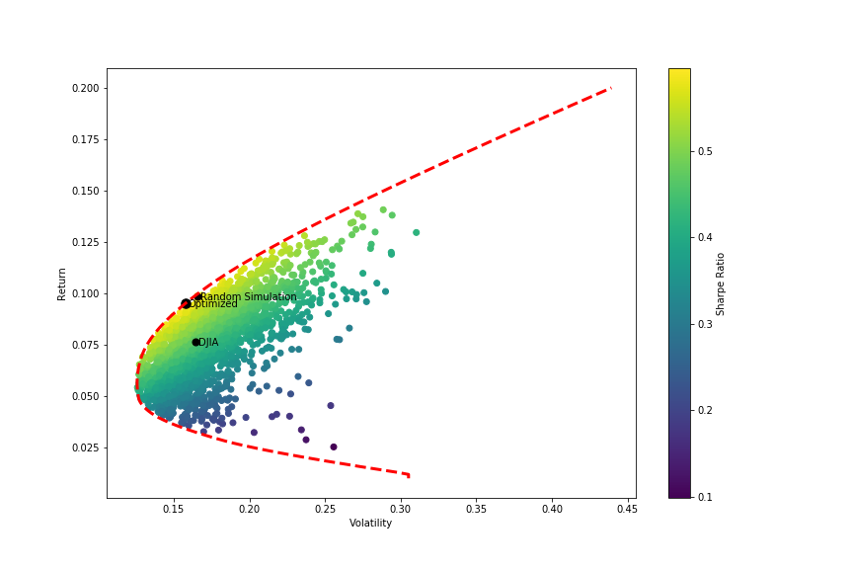
Exploring the efficient frontier

Slide 7
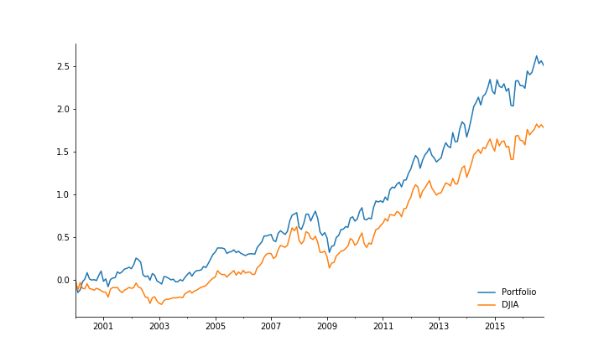
Exploring the efficient frontier
Training Performance

Slide 8

Success!

Slide 9
Success!
SORT OF

Slide 10
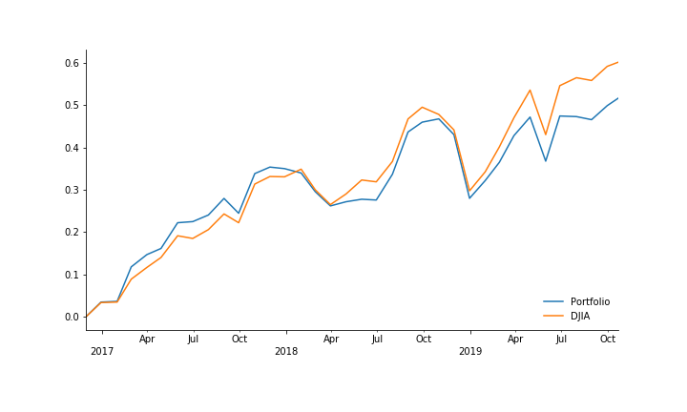
How results carry forward
Test Performance
“It’s tough to make predictions, especially about the future.” -Yogi Berra

Slide 11
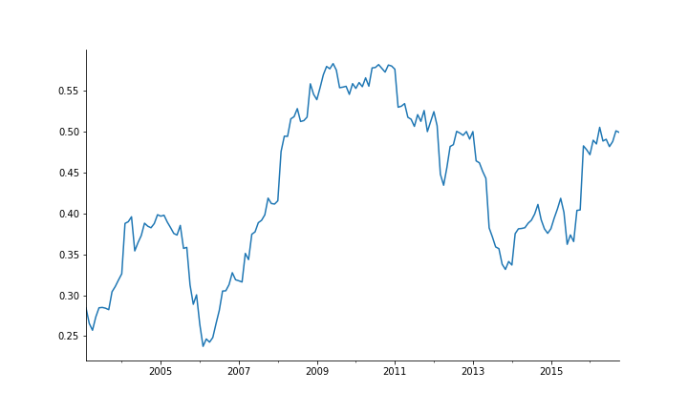
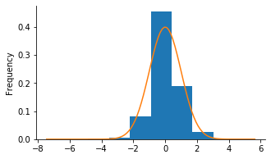
Data stationarity
Average Correlation
Returns are non-stationary and non normally distributed

Slide 12
Takeaways and implications
Markets are highly efficient and heavily mined on pricing data.
Backwards looking strategies based on known data are typically incorporated in pricing.
Strategies based on historical data are generally undermined by violated assumptions.

Slide 13
Inconclusion
“The efficient market theory is one of the better models in the sense that it can be taken as true for every purpose I can think of. For investment purposes, there are very few investors that shouldn't behave as if markets are totally efficient.”
~Eugene Fama (Nobel Prize in Economics)
“If I subscribed to the efficient market theory, I would still be delivering papers.”
~Warren Buffett (Rich)

